Slide 1
Wine Enthusiasts
Understanding the Components of Wine Ratings
Alcohol Analytics Team:
Pinmanee Eowpittayakul, James Gilson, Frederic Li, Leah Reinhard, Xinyuan Zhu

Slide 2
Introduction
Dataset with 129,972 rows and 13 variables - country, description, designation, points, price, province, region_1, region_2, taster_name, taster_twitter_handle, title, variety, winery
What variables are most useful in predicting wine ratings for this dataset?
Follow-up questions:
What descriptive words from the reviews help determine wine quality?
Which words tend to come out most frequently? Etc.
Step. 1
Step. 2
Step. 3
Step. 4
Step. 5
Exploration
&
Data Cleaning
Exploratory Analysis
Models:
Text Mining, Clustering, Recommender System
Conclusions
&
Recommendations
Prediction Model

Slide 3
Exploration & Data Cleaning
Based on utility - a purchaser will always know the price of the wine they are buying, but quality generally can’t be determined until the bottle has been opened.
The countries ranking for highest average wine points was different than the ranking for highest average wine price.
The wines with the highest wine prices and highest wine points were all from west Europe.
It is rare for wines to be rated high on the scale from 80-100.
The existence of a twitter handle had no effect on wine pricing.
Early Exploration
Cleaning the Data
Remove duplicate values and missing values
Remove “has_twitter” and “taster_twitter_handle” from our wine quality analysis.
Extract wine age from title
Focus analysis to wines under $200 (which is 97% of the dataset)
Change the variables “description” and “designation” data types to character values.

Slide 4
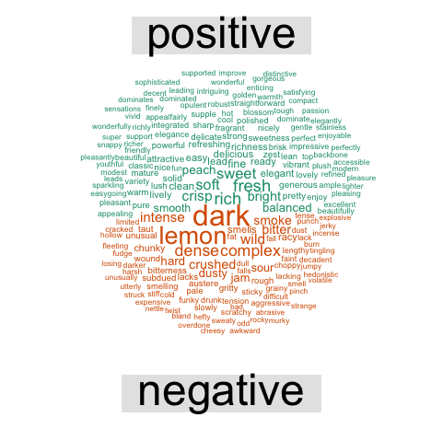
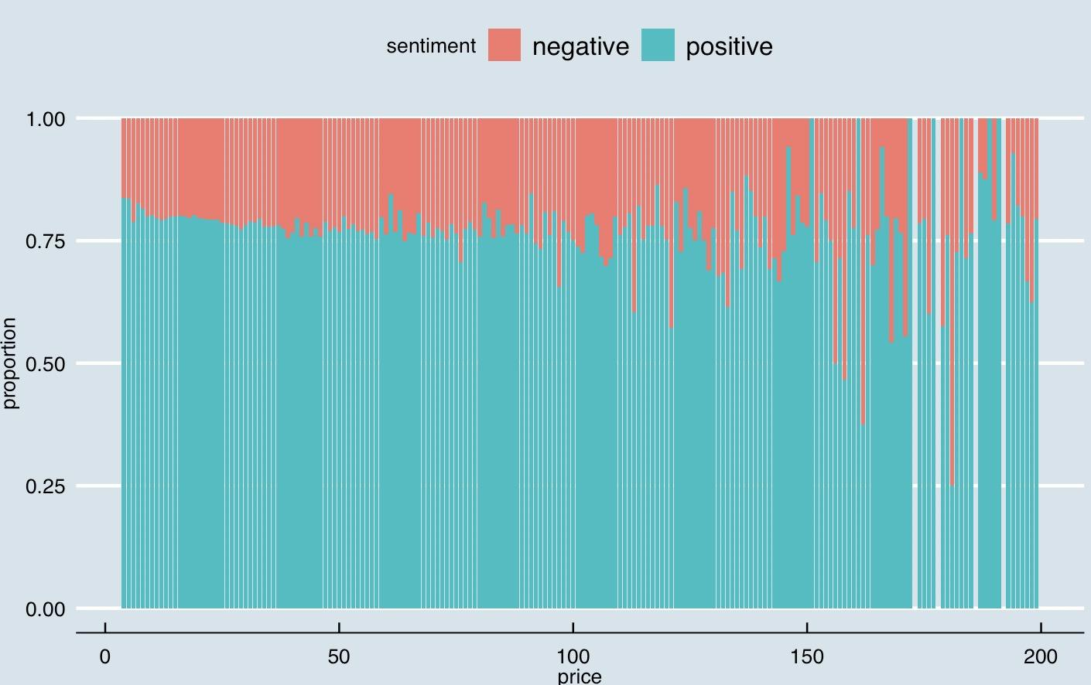
Exploratory Analysis - Text Mining
- Strong correlation between description character count and rating.
- The majority of reviews were largely positive
Negative correlation between positivity & price:
High Price =
High Expectations?
- Afinn and Bing lexicons not quite up to the task
Mischaracterized many words in the context of wine ratings
The top ten descriptive words: flavors, fruit, aromas, palate, finish, acidity, tannins, drink, cherry, and black

Slide 5
Modeling
Goal: Additional features to predict wine ratings
1
Model 1: Text Mining
Model 2: Winery Preferences
2
After running sentiment analysis, now we are ready for prediction!
Corpus for most frequent terms
Sparsity threshold of 98.5% to reduce number of words from over 30,000 to 300
Findings:
Linear Regression = best model with test RMSE of 2.11
Recommender System:
Subset data into tasters, winery, and ratings
UBCF + non-personalized recommendation methods
Factor Transformation:
- Created “wineryScore”
-Mean rating of all wines from a given winery
-Reasonably strong correlation (0.58) with test set
Notes:
Retain items that appear 1.5% of the time
Both in California, but wine with highest ratings come from Western Europe

Slide 6
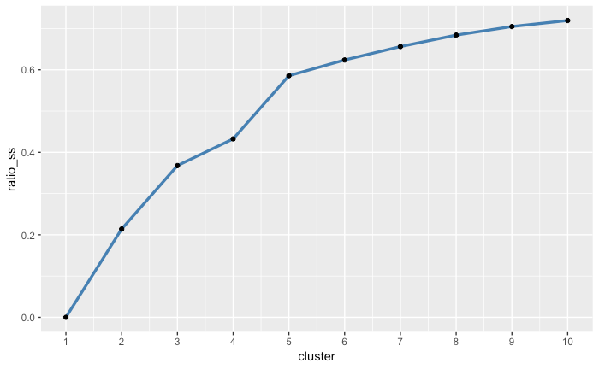
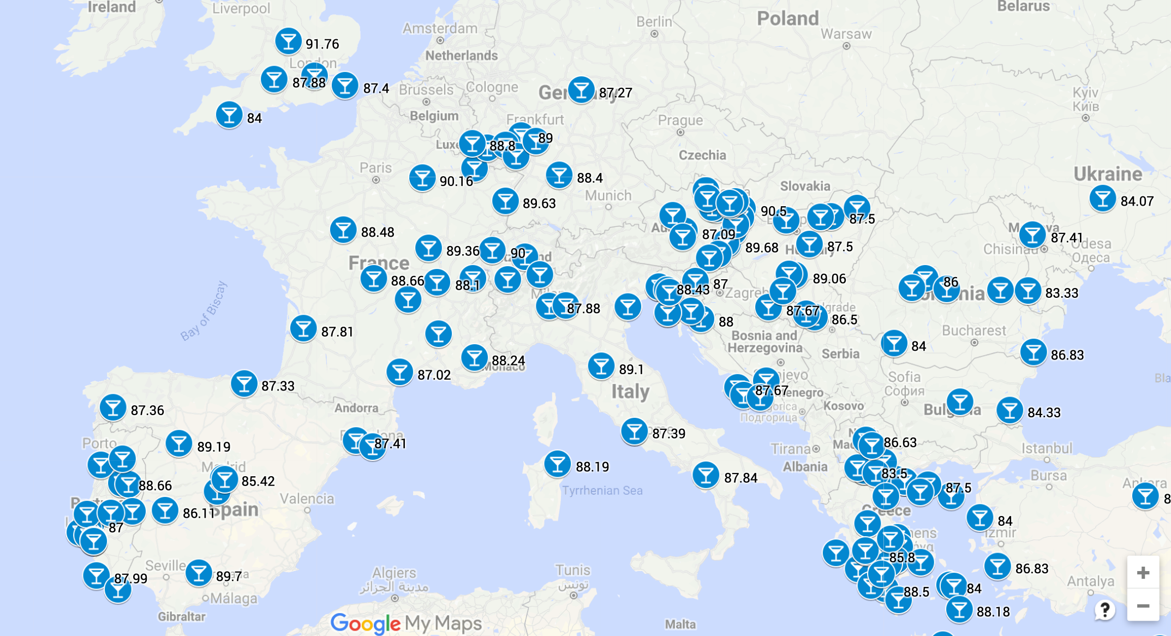
Modeling
Goal: Additional features to predict wine ratings
Model 3:
K-means clustering
3
Spatial Data
4
- Subset the data to numeric variables.
- 2 cluster + 3 cluster solution:
the elbow in the graph indicated a clustering with the lowest sse.
- This cluster analysis was created to later add as a feature to our final model.
- Created “wineryScore” to make use of Winery variable
Reasonably strong correlation (0.58) with test set
- Imported country coordinates
- Quasi-spatial analysis to visualize the wine quality of provinces identified as locations that had the best quality wine (Western Europe).
- Removed province* factor from our final model.

Slide 7
Conclusion
Model
Linear Mode
RMSE = 1.738 on the test set
What kind is better?
review sentiment, positivity, price, tasters, age, length of tasters’ reviews, longitude, average score, and how many wines the tasters have reviewed per winery
Variable
P-value
All variables except latitude are statistically significant

Slide 8
Recommendation & Limitation
- Location data is accurate on the country/province level only.
- A wine-specific lexicon for sentiment analysis
UP
- Consider the age, origin and popularity among oenophilia when purchasing wine.
- Have a wine dictionary: fruity aroma, chewy palate with nutty finish, idiosyncratic variant with distinct cellar character.
- NO: it’s good.
DOWN

Slide 9
THANK YOU
Understanding the Components of Wine Ratings
Alcohol Analytics Team

